Slide 1
UNIT-3
TREES

Slide 2
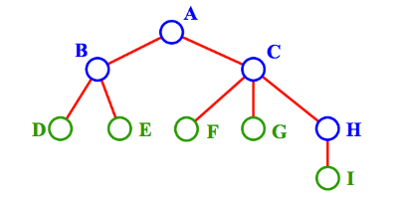
TREES
Tree represents a hierarchy
Property: Edges = Nodes − 1
TERMINOLOGY
A is the root node.
B is the parent of D and E.
C is the sibling of B
D and E are the children of B.
D, E, F, G, I are external nodes, or leaves.
A, B, C, H are internal nodes.
• The depth (height) of tree is 4 (max
number of nodes in a branch of tree, which
is 1 more than the largest level of the tree)
• The degree of node B is 2.
Level=0
Level=1
Level=2
Level=3

Slide 3
BINARY TREE
A binary tree T is defined as finite set of elements called NODES.
If T is empty- It is called NULL/EMPTY TREE
If T contains root R and two trees T1 and T2 then T1 and T2 are left and right SUBTREES of T attached to root R.
A Node in binary tree has:
0,1 or 2 successors

Slide 4
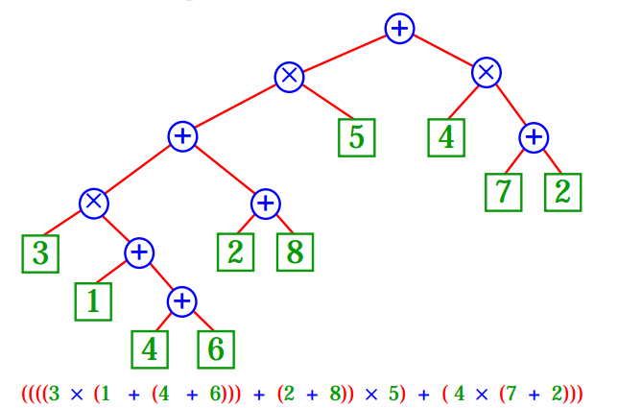
EXAMPLE OF BINARY TREE

Slide 5
PROPERTIES OF BINARY TREES
• External nodes = Internal nodes + 1
• Nodes at level i ≤ 2 ^{i}
• External nodes ≤ 2 (Height)
• Height ≥ log₂ (External nodes)
• Height ≤ Internal nodes = ((Nodes) − 1)/2

Slide 6
COMPLETE BINARY TREE
A tree T is said to be complete if all its levels, except the last, have maximum number of possible nodes
The depth of the complete tree T with nodes n is:
D= |_ log₂n+1 _|

Slide 7
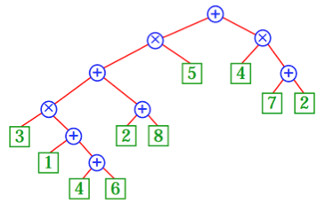
EXTENDED BINARY TREE
A Binary tree with each node having either 0 or 2 children is an extended binary tree.
The nodes with 2 children are called internal nodes, and nodes with 0 children are called external nodes.

Slide 8

REPRESENTING BINARY TREE IN MEMORY
LINKED REPRESENTATION
Consider a binary tree T, it is represented in memory using 3 parallel arrays:
INFO[K]- contains data at node N
LEFT[K]- contains the location of left child of N
RIGHT[K] - contains the location of right child of N
Where K is the location.

Slide 9
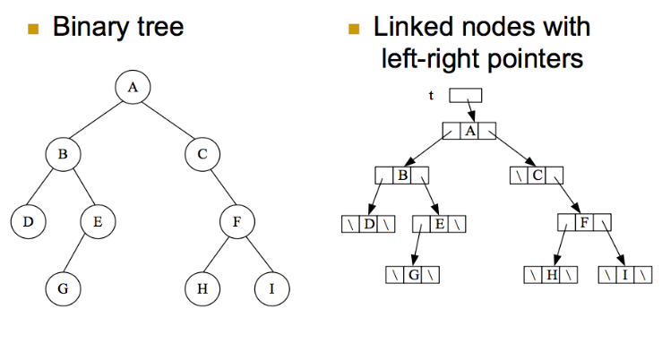
REPRESENTING BINARY TREE IN MEMORY

Slide 10
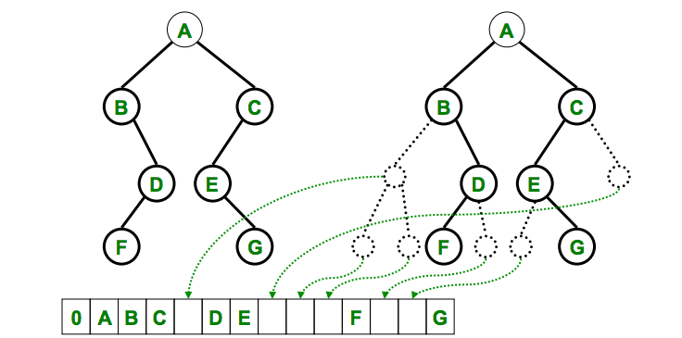
REPRESENTING BINARY TREE IN MEMORY
SEQUENTIAL REPRESENTATION
It uses contiguous memory space to store the nodes.

Slide 11
TRAVERSING BINARY TREES
PREORDER (ROOT, LEFT, RIGHT)
PreOrder (BinaryTreeNode t)
{
if (t != null)
{
visit(t);
preOrder(t.leftChild);
preOrder(t.rightChild);
}
}

Slide 12
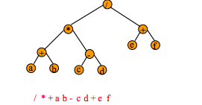
EXAMPLE

Slide 13
TRAVERSING BINARY TREES
INORDER (LEFT, ROOT, RIGHT)
InOrder (BinaryTreeNode t)
{
if (t != null)
{
InOrder(t.leftChild);
visit(t);
InOrder(t.rightChild);
}
}

Slide 14
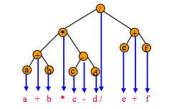
EXAMPLE

Slide 15
TRAVERSING BINARY TREES
POSTORDER (LEFT, RIGHT, ROOT)
PreOrder (BinaryTreeNode t)
{
if (t != null)
{
postOrder(t.leftChild);
postOrder(t.rightChild);
visit(t);
}
}

Slide 16
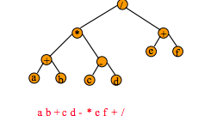
EXAMPLE

Slide 17
THREADED BINARY TREE
Hand written notes given!

Slide 18
BINARY SEARCH TREE
For every node, X, in the tree,
The values of all the keys in its left subtree are smaller than the key value of X, and
The values of all the keys in its right subtree are larger than the key value of X.
This structure enables you to search for and find an element with an average running time of
f(n)=O(log₂n)
IMPLEMENTATION:
Find – MIN, MAX
Insert
Delete

Slide 19
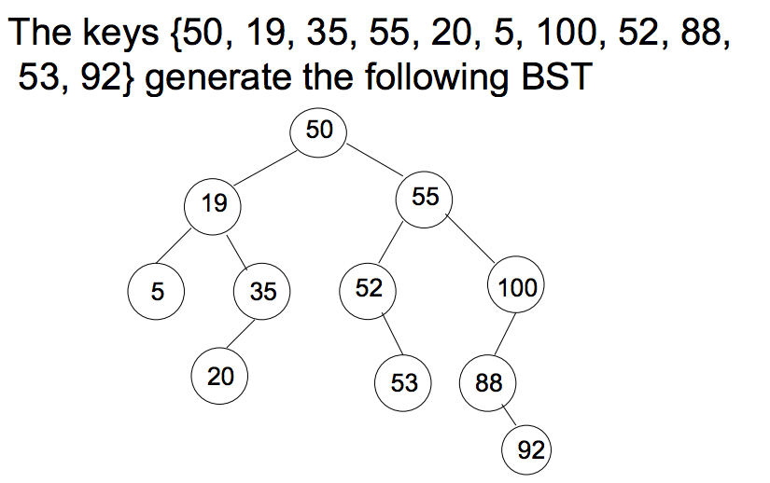
EXAMPLE

Slide 20
BST
APPLICATIONS (Ref topic 7.8, schaum’s series)
It allows us to find and delete all duplicate elements in the collection.
NOTE: hand written notes given for 4 algorithms!

Slide 21
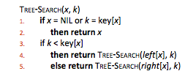
FINDING AN ELEMENT IN BST
K is the key which is searched for and X is the start node.
Time: The algorithm visiting nodes on a downward path from the root. Thus, running
time is O(h).
Ref: Cormen

Slide 22

FINDING MIN AND MAX IN BST
The binary‐search‐tree property guarantees that
The minimum key of a binary search tree is located at the leftmost node, and
The maximum key of a binary search tree is located at the rightmost node.
Time: Both procedures visit nodes that form a downward path from the root to a leaf. Both procedures run in O(h) time.
Ref: Cormen

Slide 23
COMPLEXITY OF SEARCHING ALGORITHM
A Binary tree with n elements has an average run time:
f(n)=O(log₂n)

Slide 24
SUCCESSOR
Assuming that all keys are distinct, the successor of a node x is the node y such that key[y] is the smallest key > key[x].
If x has the largest key in the binary search tree, then we say that x’s successor is NIL.
There are two cases:
If node x has a non‐empty right subtree, then x’s successor is the minimum in x’s right subtree.
If node x has an empty right subtree and x has a successor y, then y is the lowest ancestor of x whose left child is also an ancestor of x.

Slide 25
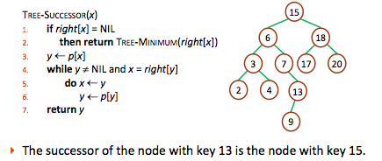
SUCCESSOR
Ref: Cormen

Slide 26
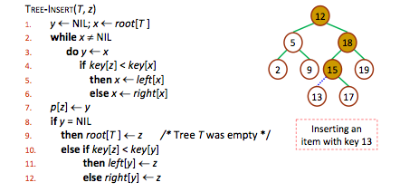
INSERTING AN ELEMENT IN BST
Adding a value to BST can be divided into two stages:
Search for a place to put a new element;
Insert the new element to this place.
Ref: Cormen

Slide 27
DELETING AN ELEMENT FROM BST
TREE‐DELETE is broken into three cases.
Case 1: z has no children.
Delete z by making the parent of z point to NIL, instead of to z.
Case 2: z has one child.
Delete z by making the parent of z point to z’s child, instead of to z.
Case 3: z has two children.
z’s successor y has either no children or one child.
(y is the minimum node with no left child in z’s right subtree.)
Delete y from the tree (via Case 1 or 2).
Replace z’s key and satellite data with y’s.

Slide 28
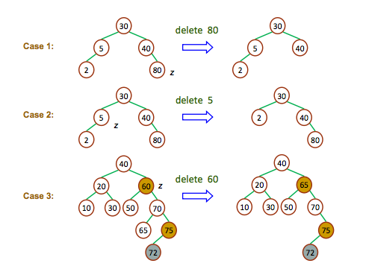
DELETING AN ELEMENT FROM BST

Slide 29
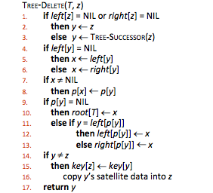
DELETING AN ELEMENT FROM BST
(Nil)
y is z’s successor
Ref: Cormen

Slide 30
AVL TREES
Hand written notes given!

Slide 31
HEAPS
Definition in Data Structure
Heap: A special form of complete binary tree that key value of each node is larger or smaller than the key value of its children (if any).
Max-Heap: root node has the largest key.
A max tree is a tree in which the key value in each node is larger than or equal to the key values in its children. A max heap is a complete binary tree that is also a max tree.
Min-Heap: root node has the smallest key.
A min tree is a tree in which the key value in each node is smaller than or equal to the key values in its children. A min heap is a complete binary tree that is also a min tree.

Slide 32
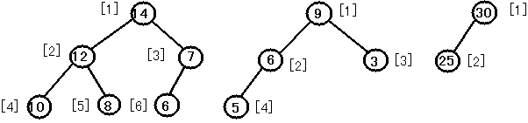
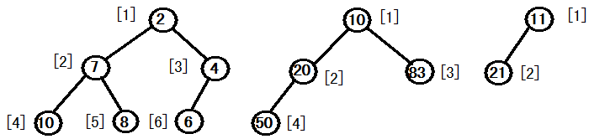
HEAPS
Example:
Max-Heap
Min-Heap

Slide 33
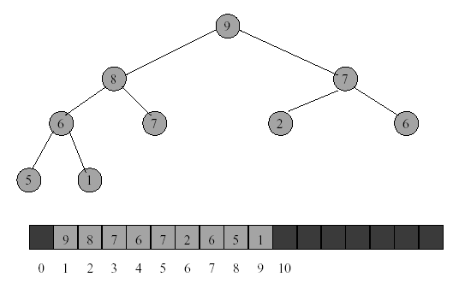
ARRAY REPRESENTATION OF HEAPS

Slide 34
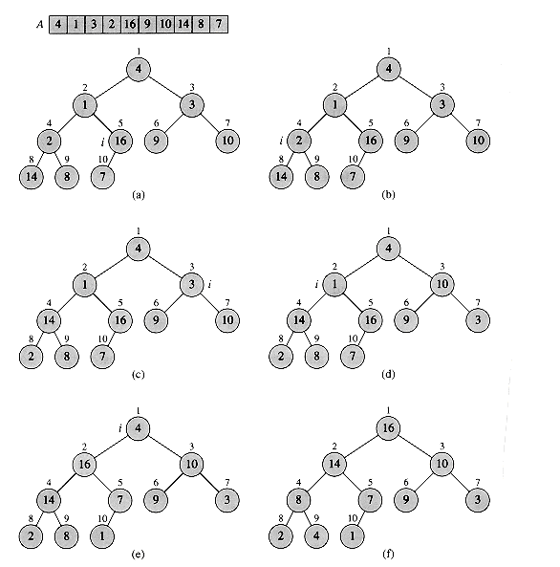
BUILDING A HEAP

Slide 35
INSERTING INTO A HEAP
Consider a heap-H having N-elements, an array TREE with N elements, ITEM which is to be inserted, PTR which is the location of ITEM and PAR is the location of parent of ITEM.
INSHEAP(TREE,N,ITEM)
N=N+1; PTR=N; //Add a new element to H and initialise PTR
Find the location to insert ITEM; repeat steps 3 to 6 while PTR>1
Set PAR=|_PTR/2_|
If ITEM<=TREE[PAR]
Set TREE[PTR]=ITEM and return;
5. Set TREE[PTR]=TREE[PAR] //moves node down
Set PTR=PAR //updates pointer
6. Set TREE[1]=ITEM and return; //Assign ITEM as root of H ;

Slide 36
INSERTING INTO A HEAP
97
88
66
55
95
95
66
35
18
40
30
26
48
55
24
-
48
62
77
25
38
Insert 70 into the given HEAP H.
97
88
66
70
95
95
66
35
18
40
30
26
55
55
24
48
48
62
77
25
38
Resultant Heap

Slide 37
DELETING THE ROOT OF A HEAP
This algorithm deletes root of H and reheaps the rest of the elements.
It assigns the root TREE[1] of H to a variable ITEM and the reheaps.
Consider a heap-H having N-elements, an array TREE with N elements, LAST which stores original last node of H, PTR which stores the location of LAST and LEFT,RIGHT which stores location of Left and right child of LAST.

Slide 38
DELETING THE ROOT OF A HEAP
DELHEAP(TREE,N,ITEM)
Set ITEM=TREE[1] //Removes root of H
Set LAST=TREE[N] and N=N-1 //Removes last node of H
Set PTR=1,LEFT=2 and RIGHT=3 //initialise pointers
repeat steps 5 to 7 while RIGHT<=N
If LAST>=TREE[LEFT]
LAST>=TREE[RIGHT]
then set TREE[PTR]=LAST and return;
If TREE[RIGHT]<=TREE[LEFT]
Set TREE[PTR]=TREE[LEFT]
and PTR=LEFT
Else
Set TREE[PTR]=TREE[RIGHT]
and PTR=RIGHT
Set LEFT=2*PTR
RIGHT=LEFT+1
If LEFT=N and LAST<TREE[LEFT] then set PTR=LEFT
Set TREE[PTR]=LAST

Slide 39
DELETING THE ROOT OF A HEAP
95
85
55
33
70
30
15
20
15
22
65
Perform deletion operation
85
55
22
33
70
30
15
20
15
-
65
Heap after deletion

Slide 40
HEAPSORT
HEAPSORT(TREE,N)
Call INSHEAP(TREE,N,ITEM)
Build a heap H
Sort TREE by repeatedly deleting root of H
Repeat while N>1
Call DELHEAP(TREE,N,ITEM)
Set TREE[N+1]=ITEM
Exit
COMPLEXITY: O(n log₂ n)

Slide 41
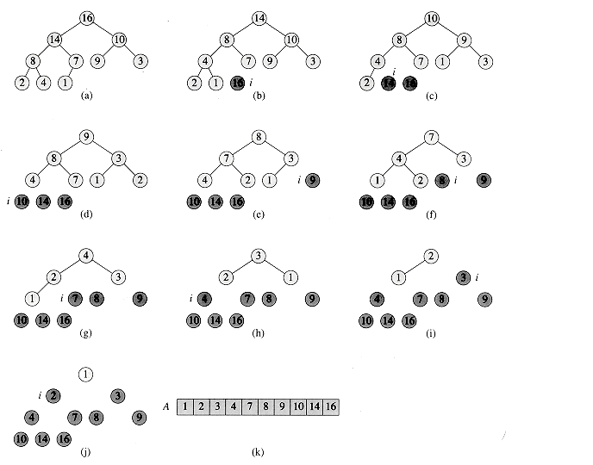
HEAPSORT

